Slide 1
Building the business migration case with Windows Server and SQL Server
September 2022

Slide 2
Abstract and learning objectives
In this whiteboard design session, you will look at how to design for converting/extending an existing IaaS deployment for resiliency. Throughout the whiteboard design session, you will look at the various configuration options and services to help build resilient architectures.
At the end of the workshop, you will be better able to design and use resiliency concepts including high availability with Availability Zones, disaster recovery for virtual machines to another region using Azure Site Recovery, and SQL Server high availability and disaster recovery using AlwaysOn Availability Groups. You will also learn how to assess the availability SLA, RPO and RTO of your design, and how to use Azure Backup to protect and secure your SQL data and VMs against corruption and loss.
You will also discuss how to achieve a similar level of resiliency for a PaaS-based implementation the same application, based on Azure App Service and Azure SQL Database. Finally, you will consider the costs associated with both approaches.

Slide 3
Step 1: Review the customer case study
Outcome
Analyze your customer needs.
Timeframe
15 minutes

Slide 4
Customer situation
Tailspin Toys is a global manufacturer of children’s toys headquartered in Milwaukee, WI
They are currently hosting mission critical workloads in on-premises datacenter
Kaylee Frye, CTO of Tailspin, has already had their Technical Architects create an assessment of their current environment, of which they’ve already identified apps and workloads to migrate first.
Their workloads are primarily Windows Server and SQL Server VMs
Their on-premises environment consists of over 250 servers and VMs and are hosted using Hyper-V

Slide 5
Customer situation - continued
They’ve identified some initial workloads they’d like to migrate first including Window Server VMs hosting .NET Framework applications and SQL Server databases.
They’ve also identifies some additional workloads that will remain on-premises but would like to ease their management burden.

Slide 6
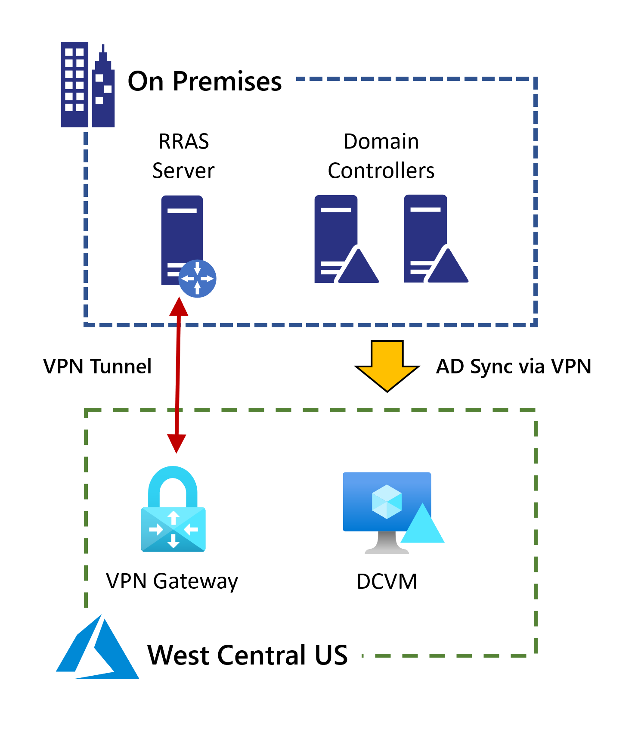
Current Active Directory Configuration
Currently have a single domain controller deployed in west central US
Connectivity is enabled with a site-to-site VPN gateway

Slide 7
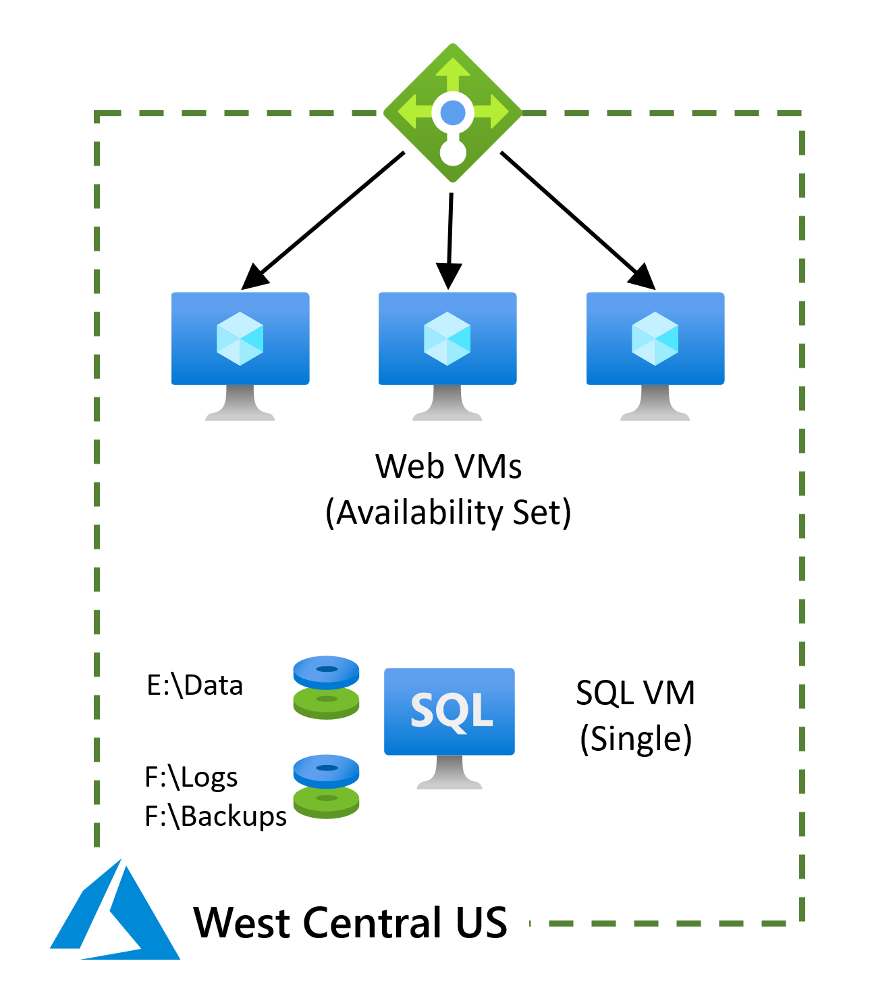
Current configuration for claims application
Web servers deployed into an availability set
SQL Server backend (single VM)
West Central US

Slide 8
Customer needs
Migrate existing workloads to Azure as efficiently as possible.
Lower the management burden with a consolidated view to manage VMs and Servers across Azure and on-premises
Network security is extremely important as we integrate on-premises networking with Microsoft Azure

Slide 9
Customer needs - continued
?
?
?
Contoso also want to fully understand the costs associated with each of 1 – 6 above.

Slide 10
Customer objections
It appears there are multiple options of hosting SQL databases in Azure. What's the best option to choose, and how do you know it'll be compatible?
What kind of downtime will be incurred when migrating the Windows Server and SQL Server workloads to Azure?
Will we be able to rollback to the on-premises VMs if the migration fails?

Slide 11
Customer objections (continued)
Tailspin has negotiated an Enterprise Agreement (EA) with Microsoft for their Azure consumption. Any cost estimates need to reflect their EA discount.
Would there be further savings from the use of PaaS services?

Slide 12
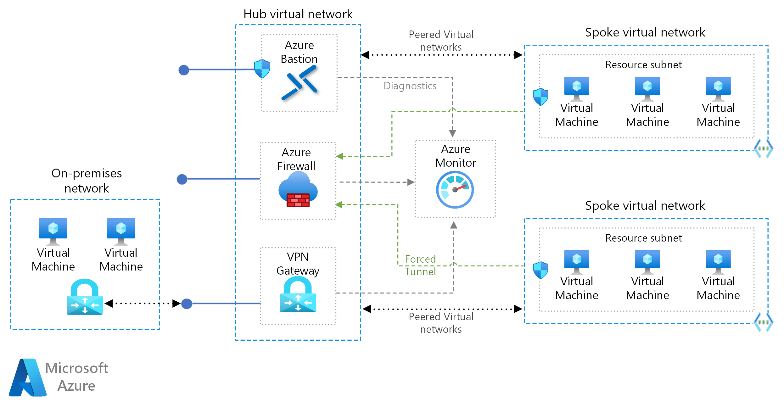
Common scenarios

Slide 13
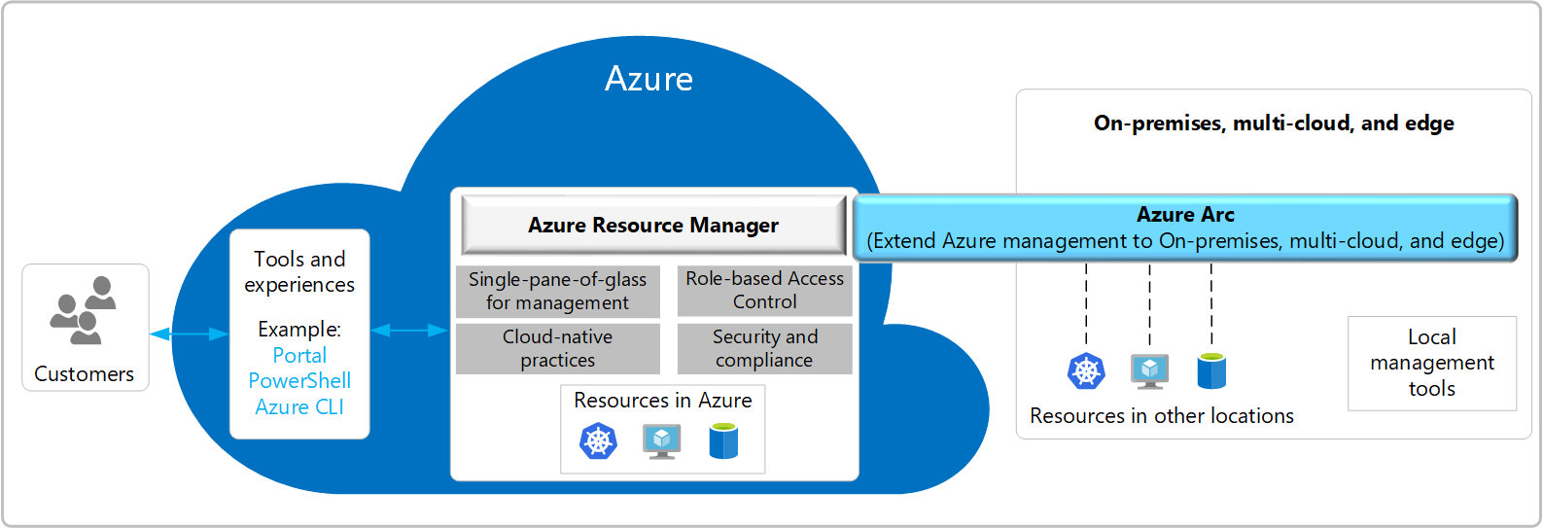
Common scenarios

Slide 14
Step 2: Design the solution
Outcome
Design a solution and prepare to present the solution to the target customer audience in a 15-minute chalk-talk format.
Timeframe
1-2 hours
Business needs | Respond to questions outlined in your student guide and be prepared to present your solution to others.
Design | Design a solution for as many of the requirements in your student guide as time allows.
Pricing | Provide an estimate of the costs associated with each aspect of your solution, following the questions in your student guide.
Prepare | Identify any customer needs that are not addressed with the proposed solution. Identify the benefits of your solution. Determine how you will respond to the customer’s objections. Prepare for a 15-minute presentation to the customer.

Slide 15
Step 3: Present the solution
Outcome
Present a solution to the target customer in a 15-minute chalk-talk format.
Timeframe
30 minutes (15 minutes for each team to present and receive feedback)
Directions
Pair with another team.
One group is the Microsoft team and the other is the customer.
The Microsoft team presents their proposed solution to the customer.
The customer asks one of the objections from the list of objections in the case study.
The Microsoft team responds to the objection.
The customer team gives feedback to the Microsoft team.
Switch roles and repeat Steps 2-6.

Slide 16
Wrap-up
Outcome
Review the preferred solution for the case study.
Timeframe
15 minutes

Slide 17
Preferred target audience
Kaylee Frye, CTO
Technical Architects

Slide 18
Solution Outcome 1
?
?
?

Slide 19
Solution Outcome 2
?
?
?

Slide 20
Customer objections
Objection
It appears there are multiple options of hosting SQL databases in Azure. What's the best option to choose, and how do you know it'll be compatible?
Potential answer
Microsoft Azure does provide multiple options for hosting SQL databases. Azure SQL refers to a family of managed, secure, and intelligent products that use the SQL Server database engine in the Azure cloud. There is some overlap between the different options available, with each targeting different use cases, scenarios and business motivations.
For Tailspin Toys, it is recommended to use Azure SQL Managed Instances (SQL MI) for migrating the SQL Server databases to Azure. SQL MI provides near 100% compatibility with on-premises SQL Server database instances and includes features to best handle the common isolation and security concerns required by Tailspins organization.

Slide 21
Customer objections
Objection
What kind of downtime will be incurred when migrating the Windows Server and SQL Server workloads to Azure?
Potential answer
All application tiers and database will be deployed to the Azure VMs in parallel to the on-premises VMs. This will enable minimal downtime when application load is redirected to the new VMs.
To ensure data consistency during the migration, there will be a short window of downtime required at the database level when the cut over to the new servers is performed. Data migration using DMS supports online migration, allowing the applications to be kept online while data is synchronized.

Slide 22
Customer objections
Objection
Will we be able to rollback to the on-premises VMs if the migration fails?
Potential answer
The migration process will be designed to create new application deployments within their CI/CD pipelines to release to the new Windows Server 2022 VMs in Azure in parallel to the existing on-premises VMs. This will allow traffic to be cut over to the new VMs when ready.
In the event of an unexpected issue during migration, the existing on-premises VMs, application deployments and databases will remain in place as a fall back. If there is an issue detected during the cut over process, the on-premises servers will be able to immediately pick up where they left off.

Slide 23
Customer objections
Objection
Tailspin has negotiated an Enterprise Agreement (EA) with Microsoft for their Azure consumption. Any cost estimates need to reflect their EA discount.
Potential answer
We absolutely want to take advantage of these savings for them! The cost estimates from the Azure Pricing Calculator can be tailored to reflect their EA discount.

Slide 24
Customer objections
Objection
Would there be further savings from the use of PaaS services?
Potential answer
Further evaluation of the front-end and back-end .NET Framework applications will be necessary to determine the requirements for hosting these applications using Azure App Service. Azure App Service Web Apps provide a PaaS hosting option for applications that further reduces the management burden over IaaS VMs, and does support hosting applications build with .NET Framework, and .NET Core, among other development languages.
Azure Kubernetes Service (AKS) is another potential option for hosting applications. For Tailspin Toys, this may not be the best option as it would require further redesign and architecture of the applications to host in AKS. If Azure App Service doesn't meet the requirements of Tailspin Toys applications, then AKS may offer an alternative that fits better.

Slide 25
Customer quote
“We recognized the need and benefits to migrating our aging infrastructure to Azure. I know this migration is going to help us increase reliability while lowering operation and maintenance costs. I'm really looking forward to the shiny new capabilities we are now able to take advantage of, including the ability to manage our on-premises and Azure VMs using Azure Arc.”
— Kaylee Frye, CTO, Tailspin Toys

